Slide 1
Getting start with the Framework Tutorial @ IE2025
Dr.-Ing. Christian Beyer | 24.06.2025
christian.beyer@ovgu.de
Notes:
Multi-Task Learning → partly true, →do not share structure unless ensemble → different training data but same task
Recommenders rely user-user or item-item similarities. -> ignored
Recommenders often aggregate data across entities. ->not yet.
Recommenders seek cross-entity generalization (e.g., new users/items).
Entity-centric learning focuses on intra-entity generalization, avoiding global patterns.

Slide 2
Content
Setup
Running experiments

Slide 3
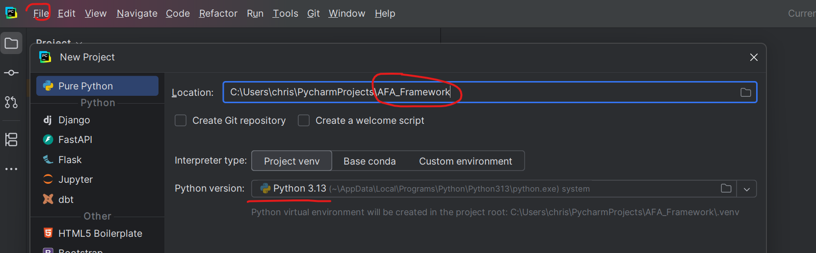
Setup
Use preferred python IDE e.g. Pycharm
Get framework code from github or cloud
Create a new project using Python 3.13
Notes:
Maybe explain active learning briefly

Slide 4
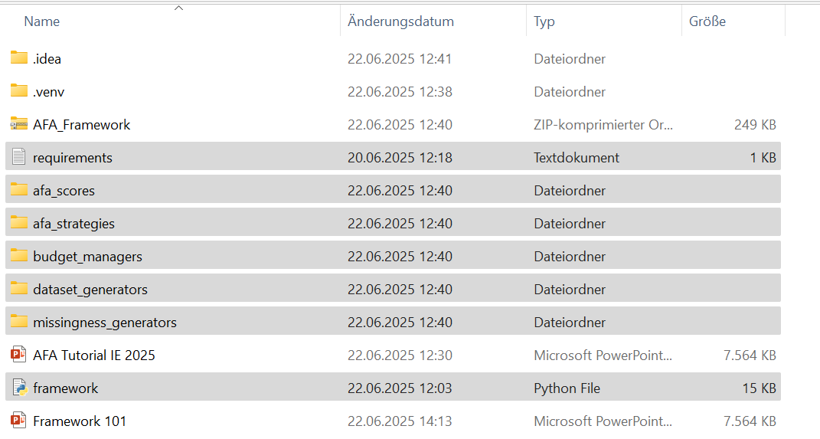
Setup
add the selected files from the zip file into your projects folder
Notes:
Maybe explain active learning briefly

Slide 5
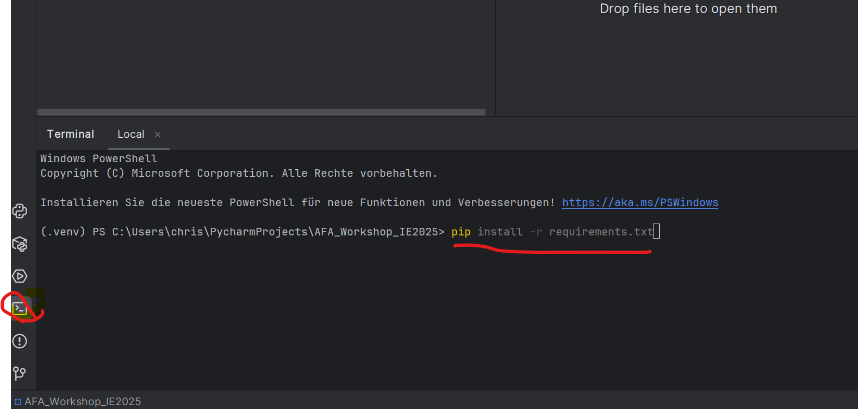
Setup
Go to console and run: pip install -r requirements.txt
Notes:
Maybe explain active learning briefly

Slide 6
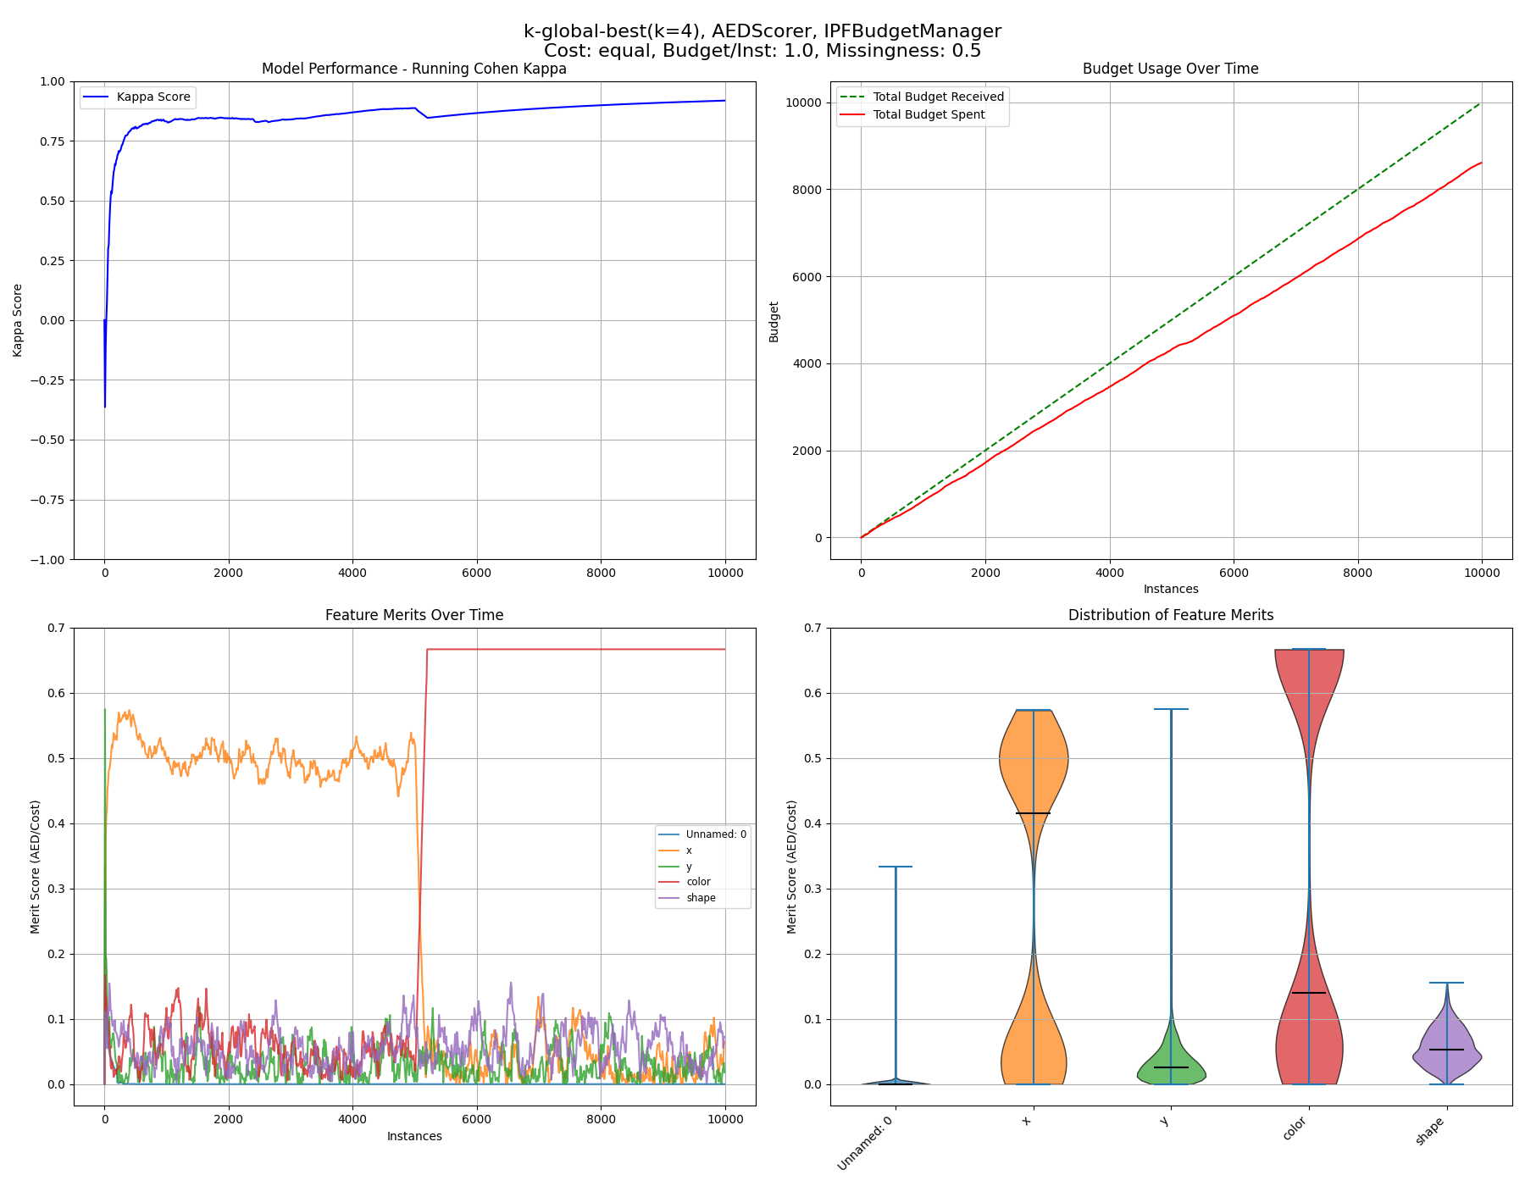
Setup
Open the framework.py and run it
Notes:
Maybe explain active learning briefly

